Slide 1
Module - 6
Fundamental Cloud Security and Mechanisms

Slide 2
Contents
Basic terms and concepts
Threat agents
Cloud security threats
Encryption
Hashing
Digital Signature
Public Key Infrastructure (PKI)
Identity and Access Management (IAM)
Single Sign-On (SSO)
Cloud Based Security Groups
Hardened Virtual Server Machines

Slide 3
Basic terms and concepts
Information security is a complex ensemble of technologies, techniques regulations that collaboratively protect the integrity and access to system and data.
IT security measures aim is to defend against threats and interference that arise from malicious and unintentional user error.
Confidentiality
Means only authorized persons can accessible. In cloud environment confidentiality means restricting access to data while transmitting and storage.

Slide 4
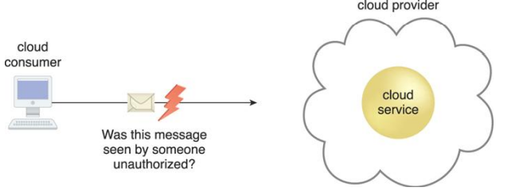
Contin..
Confidentiality
Means only authorized persons can accessible. In cloud environment confidentiality means restricting access to data while transmitting and storage.
Fig: The message issued by the cloud consumer to the cloud service is considered confidential only if it is not accessed or read by an unauthorized party.

Slide 5
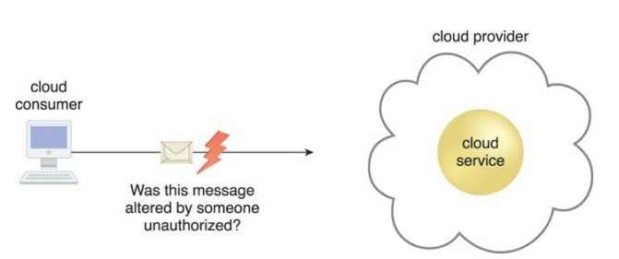
Integrity
The data can’t be altered by the third party. In cloud environment the integrity issue is that whether the cloud consumer be guaranteed that the data transmit to the cloud matches the data received by the cloud service.
Fig: The message issued by the cloud consumer to the cloud service is considered to have integrity if it has not been altered.

Slide 6
Authenticity
Authenticity is the characteristic of something having been provided by an authorized source. Authentication in non-repudiable interactions provides proof that these interactions are uniquely linked to an authorized source.
Availability
Availability is the characteristic of being accessible and usable during a specified time period.
In typical cloud environments, the availability of cloud services can be a responsibility that is shared by the cloud provider and the cloud carrier.

Slide 7
Threat
A threat is a potential security violation that can challenge defenses in an attempt to breach privacy and/or cause harm.
Vulnerability
A vulnerability is a weakness that can be exploited either by insufficient security controls, or because existing security controls are overcome by an attack.
Risk
Risk is the possibility of loss or harm arising from performing an activity. Risk is typically measured according to its threat level and the number of possible or known vulnerabilities.
Two metrics can be used to determine risk for IT resources.
The probability of a threat occurring to exploit vulnerabilities in the IT resource
• The expectation of loss upon the IT resource being compromised.

Slide 8
Security Controls
Security controls are countermeasures used to prevent or respond to security threats and to reduce or avoid risk.
Security Mechanisms
Countermeasures are typically described in terms of security mechanisms, which are components comprising a defensive framework that protects IT resources, information, and services.
Security Policies
A security policy establishes a set of security rules and regulations.
For example, the positioning and usage of security controls and mechanisms can be determined by security policies.

Slide 9
Threat Agents
A threat agent is an entity that poses a threat because it is capable of carrying out an attack.
Cloud security threats can originate either internally or externally, from humans or software programs.

Slide 10
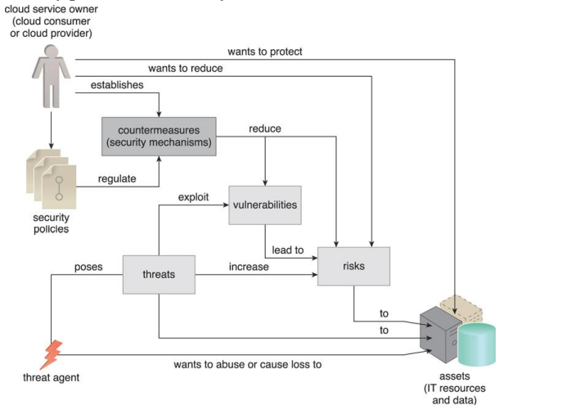
The role a threat agent assumes in relation to vulnerabilities, threats, and risks, and the safeguards established by security policies and security mechanisms.

Slide 11

Anonymous Attacker
An anonymous attacker is a non-trusted cloud service consumer without permissions in the cloud.
It typically exists as an external software program that launches network-level attacks through public networks.
When anonymous attackers have limited information on security policies and defenses, it can inhibit their ability to formulate effective attacks.
Fig: The notation used for an anonymous attacker.

Slide 12

Malicious Service Agent
A malicious service agent is able to intercept and forward the network traffic that flows within a cloud.
It may also exist as an external program able to remotely intercept and potentially corrupt message contents.
Fig: The notation used for a malicious service agent

Slide 13

Trusted Attacker
A trusted attacker exists as an authorized cloud service consumer with legitimate credentials that it uses to exploit access to cloud-based IT resources.
Fig: The notation that is used for a trusted attacker.

Slide 14
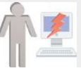
Malicious Insider
A malicious insider is a human that attempts to abuse access privileges to cloud premises.
Fig: The notation used for an attack originating from a workstation. The human symbol is optional.

Slide 15
Cloud Security Threats
The common threats and vulnerabilities in cloud based environment are
Traffic Eavesdropping
Malicious Intermediary
Denial of Service
Insufficient Authorization
Virtualization Attack
Overlapping Trust Boundaries

Slide 16
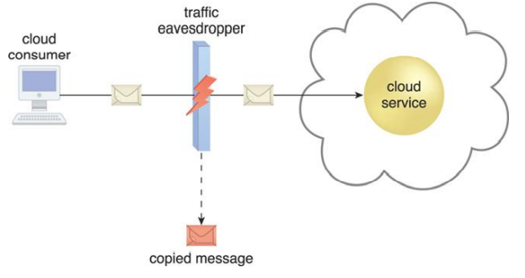
Traffic Eavesdropping
Traffic eavesdropping occurs when data being transferred to or within a cloud (usually from the cloud consumer to the cloud provider) is passively intercepted by a malicious service agent for illegitimate information gathering purposes.
Fig: An externally positioned malicious service agent carries out a traffic eavesdropping attack by intercepting a message sent by the cloud service consumer to the cloud service. The service agent makes an unauthorized copy of the message before it is sent along its original path to the cloud service.

Slide 17
Malicious Intermediary
The malicious intermediary threat arises when messages are intercepted and altered by a malicious service agent, thereby potentially compromising the message’s confidentiality and/or integrity.
It may also insert harmful data into the message before forwarding it to its destination

Slide 18
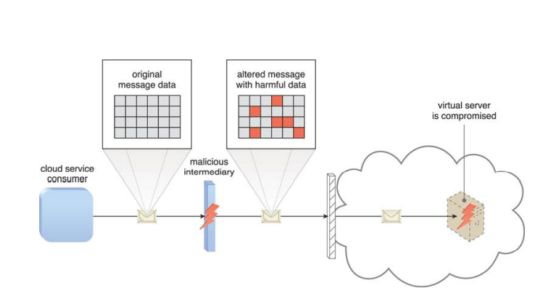
Fig: The malicious service agent intercepts and modifies a message sent by a cloud service consumer to a cloud service (not shown) being hosted on a virtual server. Because harmful data is packaged into the message, the virtual server is compromised.

Slide 19
Denial of Service
The objective of the denial of service (DoS) attack is to overload IT resources to the point where they cannot function properly.
This form of attack is commonly launched in one of the following ways:
The workload on cloud services is artificially increased with imitation messages or repeated communication requests.
The network is overloaded with traffic to reduce its responsiveness and cripple its performance.
Multiple cloud service requests are sent, each of which is designed to consume excessive memory and processing resources.

Slide 20
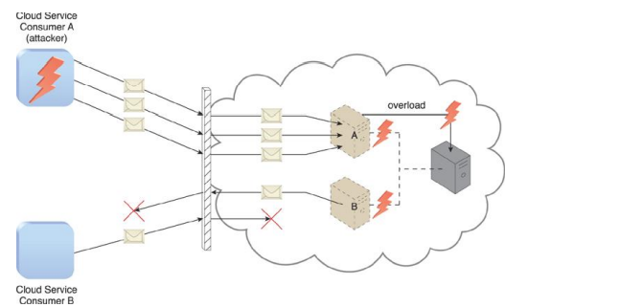
Fig: Cloud Service Consumer A sends multiple messages to a cloud service (not shown) hosted on Virtual Server A. This overloads the capacity of the underlying physical server, which causes outages with Virtual Servers A and B. As a result, legitimate cloud service consumers, such as Cloud Service Consumer B, become unable to communicate with any cloud services hosted on Virtual Servers A and B.

Slide 21
Insufficient Authorization
The insufficient authorization attack occurs when access is granted to an attacker erroneously or too broadly, resulting in the attacker getting access to IT resources that are normally protected.
This is often a result of the attacker gaining direct access to IT resources that were implemented under the assumption that they would only be accessed by trusted consumer programs.

Slide 22
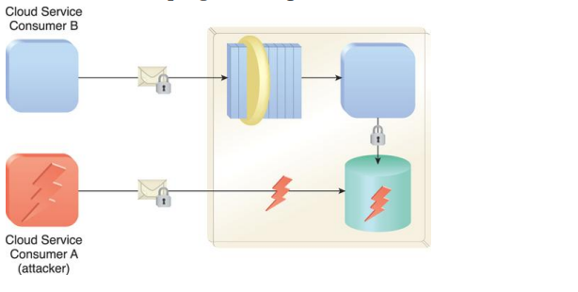
Fig: Cloud Service Consumer A gains access to a database that was implemented under the assumption that it would only be accessed through a Web service with a published service contract (as per Cloud Service Consumer B).

Slide 23
A variation of this attack, known as weak authentication, can result when weak passwords or shared accounts are used to protect IT resources.
Within cloud environments, these types of attacks can lead to significant impacts depending on the range of IT resources and the range of access to those IT resources the attacker gains

Slide 24
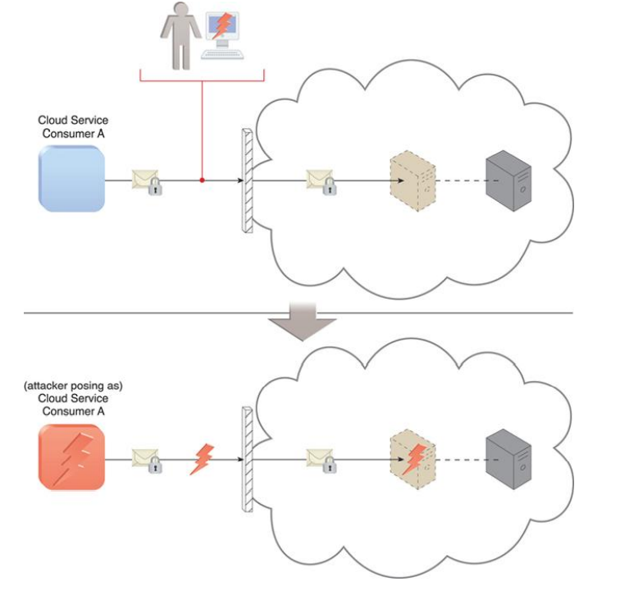
Fig: An attacker has cracked a weak password used by Cloud Service Consumer A. As a result, a malicious cloud service consumer (owned by the attacker) is designed to pose as Cloud Service Consumer A in order to gain access to the cloud-based virtual server.

Slide 25
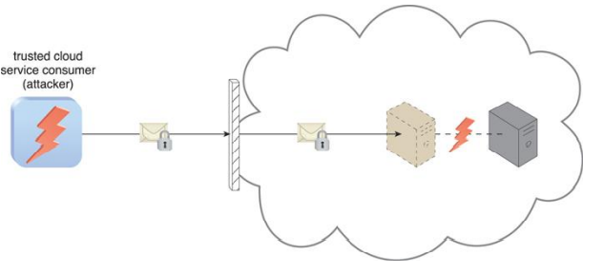
Virtualization Attack
A virtualization attack exploits vulnerabilities in the virtualization platform to expose its confidentiality, integrity, and/or availability.
where a trusted attacker successfully accesses a virtual server to compromise its underlying physical server. With public clouds, where a single physical IT resource may be providing virtualized IT resources to multiple cloud consumers, such an attack can have significant consequences.

Slide 26
Overlapping Trust Boundaries
If physical IT resources within a cloud are shared by different cloud service consumers, these cloud service consumers have overlapping trust boundaries.
Malicious cloud service consumers can target shared IT resources with the intention of compromising cloud consumers or other IT resources that share the same trust boundary.
The consequence is that some or all of the other cloud service consumers could be impacted by the attack and/or the attacker could use virtual IT resources against others that happen to also share the same trust boundary.

Slide 27
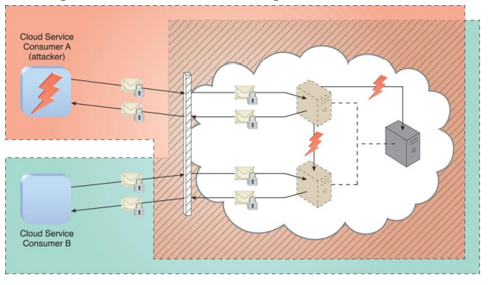
Cloud Service Consumer A is trusted by the cloud and therefore gains access to a virtual server, which it then attacks with the intention of attacking the underlying physical server and the virtual server used by Cloud Service Consumer B

Slide 28
Encryption
Encryption technology commonly relies on a standardized algorithm called a cipher to transform original plaintext data into encrypted data, referred to as ciphertext.
When encryption is applied to plaintext data, the data is paired with a string of characters called an encryption key, a secret message that is established by and shared among authorized parties.
The encryption key is used to decrypt the ciphertext back into its original plaintext format.
The encryption mechanism can help counter the traffic eavesdropping, malicious intermediary, insufficient authorization, and overlapping trust boundaries security threats.

Slide 29
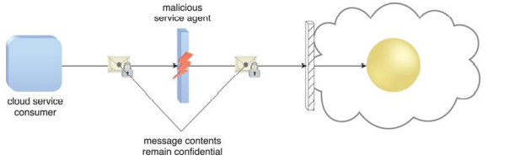
Fig: A malicious service agent is unable to retrieve data from an encrypted message. The retrieval attempt may furthermore be revealed to the cloud service consumer.

Slide 30
Types of encryption
There are two common forms of encryption
Symmetric Encryption
Asymmetric Encryption

Slide 31
Symmetric Encryption
Symmetric encryption uses the same key for both encryption and decryption, both of which are performed by authorized parties that use the one shared key.
Also known as secret key cryptography, messages that are encrypted with a specific key can be decrypted by only that same key.
A basic authentication check is always performed, because only authorized parties that own the key can create messages. This maintains and verifies data confidentiality.
Note that symmetrical encryption does not have the characteristic of non-repudiation, since determining exactly which party performed the message encryption or decryption is not possible if more than one party is in possession of the key

Slide 32
Asymmetric Encryption
Asymmetric encryption relies uses two different keys, namely a private key and a public key.
With asymmetric encryption (which is also referred to as public key cryptography), the private key is known only to its owner while the public key is commonly available.
Example: A document that was encrypted with a private key can only be correctly decrypted with the corresponding public key. Conversely, a document that was encrypted with a public key can be decrypted only using its private key counterpart.
Asymmetric Encryption is slower than symmetric Encryption.

Slide 33
Messages that were encrypted with a private key can be correctly decrypted by any party with the corresponding public key. This method of encryption does not offer any confidentiality protection, even though successful decryption proves that the text was encrypted by the rightful public key owner.
A message that was encrypted with a public key can only be decrypted by the rightful private key owner, which provides confidentiality protection in addition to authenticity and non-repudiation.

Slide 34
The encryption mechanism, when used to secure Web-based data transmissions, is most commonly applied via HTTPS, which refers to the use of SSL/TLS as an underlying encryption protocol for HTTP.
TLS (transport layer security) is the successor to the SSL (secure sockets layer) technology. Because asymmetric encryption is usually more time-consuming than symmetric encryption, TLS uses the former only for its key exchange method. TLS systems then switch to symmetric encryption once the keys have been exchanged.
Most TLS implementations primarily support RSA as the chief asymmetrical encryption cipher, while ciphers such as RC4, Triple-DES, and AES are supported for symmetrical encryption.

Slide 35
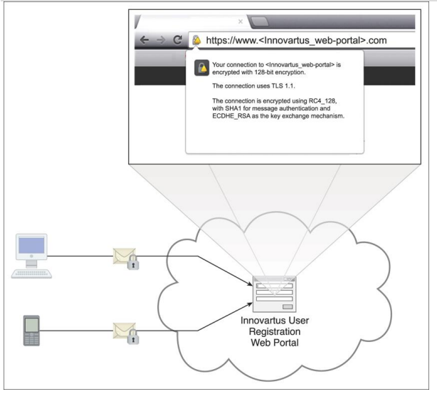
Case study:
Innovartus has recently learned that users who access their User Registration Portal via public Wi-Fi hot zones and unsecured LANs may be transmitting personal user profile details via plaintext. Innovartus immediately remedies this vulnerability by applying the encryption mechanism to its Web portal via the use of HTTPS.

Slide 36
Hashing
The hashing mechanism is used when a one-way, non-reversible form of data protection is required. Once hashing has been applied to a message, it is locked and no key is provided for the message to be unlocked. A common application of this mechanism is the storage of passwords.
Hashing technology can be used to derive a hashing code or message digest from a message, which is often of a fixed length and smaller than the original message.
The message sender can then utilize the hashing mechanism to attach the message digest to the message. The recipient applies the same hash function to the message to verify that the produced message digest is identical to the one that accompanied the message.
Any alteration to the original data results in an entirely different message digest and clearly indicates that tampering has occurred.

Slide 37
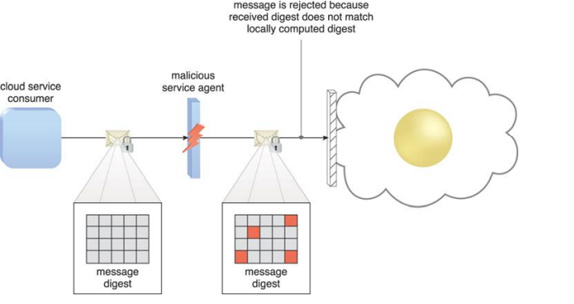
In addition to its utilization for protecting stored data, the cloud threats that can be mitigated by the hashing mechanism include malicious intermediary and insufficient authorization.
A hashing function is applied to protect the integrity of a message that is intercepted and altered by a malicious service agent, before it is forwarded. The firewall can be configured to determine that the message has been altered, thereby enabling it to reject the message before it can proceed to the cloud service.

Slide 38
Case study:
A subset of the applications that have been selected to be ported to ATN’s PaaS platform allows users to access and alter highly sensitive corporate data. This information is being hosted on a cloud to enable access by trusted partners who may use it for critical calculation and assessment purposes. Concerned that the data could be tampered with, ATN decides to apply the hashing mechanism as a means of protecting and preserving the data’s integrity.
Solution: ATN cloud resource administrators work with the cloud provider to incorporate a digest-generating procedure with each application version that is deployed in the cloud. Current values are logged to a secure on-premise database and the procedure is regularly repeated with the results analyzed.

Slide 39
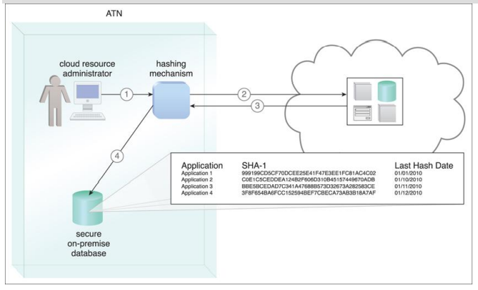
A hashing procedure is invoked when the PaaS environment is accessed (1). The applications that were ported to this environment are checked (2) and their message digests are calculated (3). The message digests are stored in a secure on-premise database (4), and a notification is issued if any of their values are not identical to the ones in storage.

Slide 40
Digital Signature
The digital signature mechanism is a means of providing data authenticity and integrity through authentication and non-repudiation.
A digital signature provides evidence that the message received is the same as the one created by its rightful sender.
Both hashing and asymmetrical encryption are involved in the creation of a digital signature, which essentially exists as a message digest that was encrypted by a private key and appended to the original message.
The recipient verifies the signature validity and uses the corresponding public key to decrypt the digital signature, which produces the message digest.
The hashing mechanism can also be applied to the original message to produce this message digest.

Slide 41
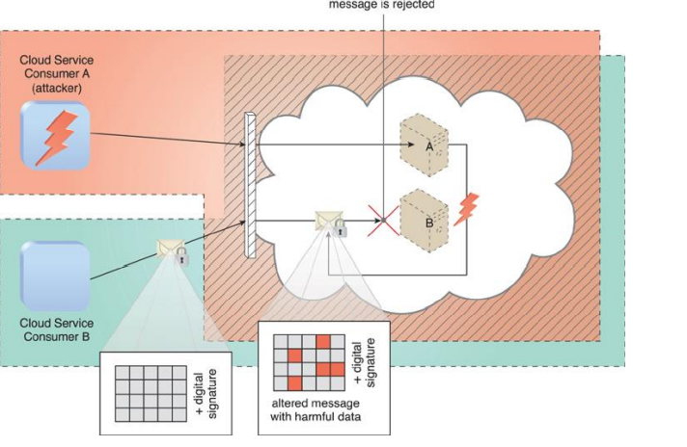
The digital signature mechanism helps mitigate the malicious intermediary, insufficient authorization, and overlapping trust boundaries security threats.
Cloud Service Consumer B sends a message that was digitally signed but was altered by trusted attacker Cloud Service Consumer A. Virtual Server B is configured to verify digital signatures before processing incoming messages even if they are within its trust boundary. The message is revealed as illegitimate due to its invalid digital signature, and is therefore rejected by Virtual Server B.

Slide 42
Case Study Example
With DTGOV’s client portfolio expanding to include public-sector organizations, many of its cloud computing policies have become unsuitable and require modification. Considering that public-sector organizations frequently handle strategic information, security safeguards need to be established to protect data manipulation and to establish a means of auditing activities that may impact government operations.
Solution: DTGOV proceeds to implement the digital signature mechanism specifically to protect its Web-based management environment. virtual server self-provisioning inside the IaaS environment and the tracking functionality of real-time SLA and billing are all performed via Web portals. As a result, user error or malicious actions could result in legal and financial consequences.

Slide 43
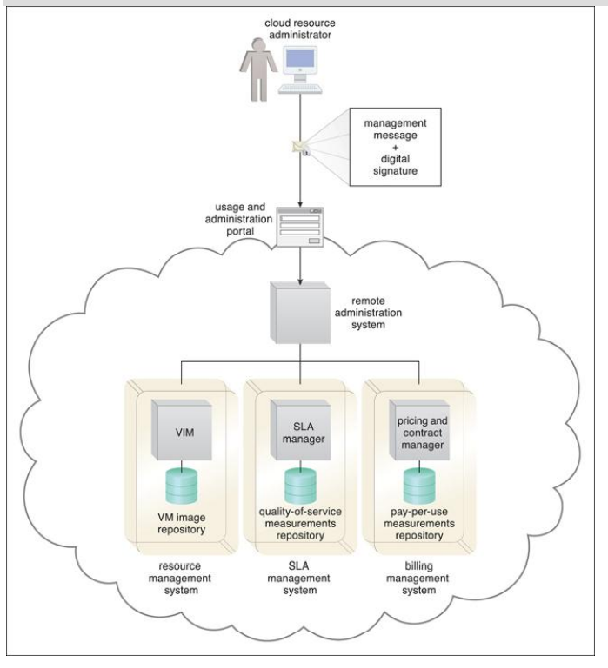
Whenever a cloud consumer performs a management action that is related to IT resources provisioned by DTGOV, the cloud service consumer program must include a digital signature in the message request to prove the legitimacy of its user.

Slide 44
Digital signatures provide DTGOV with the guarantee that every action performed is linked to its legitimate originator.
Unauthorized access is expected to become highly improbable, since digital signatures are only accepted if the encryption key is identical to the secret key held by the rightful owner.

Slide 45
Public Key Infrastructure (PKI)
A common approach managing the issue of asymmetric keys is based on the public key infrastructure(PKI) mechanism.
Which exists as a system of protocols, data formats, rules and that provides security for large scale systems using public key cryptography.
This system is used to associate public keys with their corresponding key owners known as public key identification used for verification key validity.
PKI are used in digital certificates which are digitally signed data structures that bind public keys to certificate owner identities and related information such as validity periods.
Digital certificate is a small file on computer its extension is .cer. It establish a relationship between user and public key.
Which are issued by Digital certificate authority.

Slide 46
Digital certificate contains the following information like
Username: xyz
Public key: 2#4&5$
Serial no:12345
Other info: xyz@gmail.com
Valid from: 4-5-21
Valid to: 5-8-22
Issuer name: verifying
X.509 defines the standard of digital certificates.

Slide 47
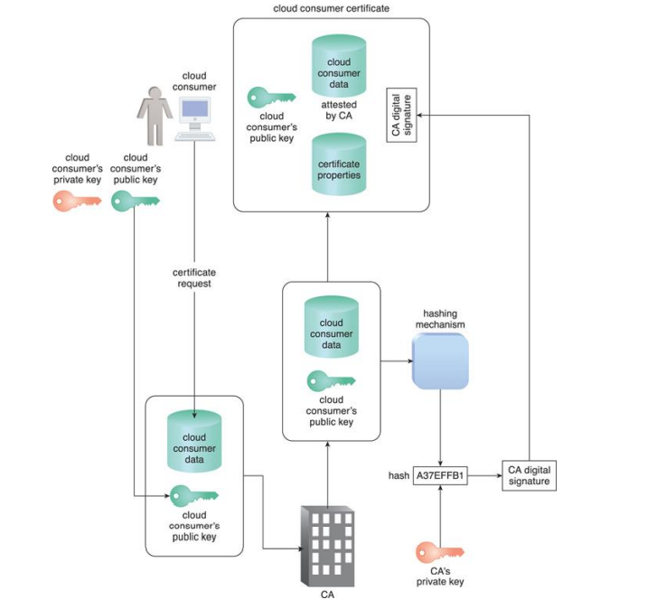
The common steps involved during the generation of certificates by a certificate authority.

Slide 48
Case study example
DTGOV requires that its clients use digital signatures to access its Web based management environment. These are to be generated from public keys that have been certified by a recognized certificate authority.

Slide 49
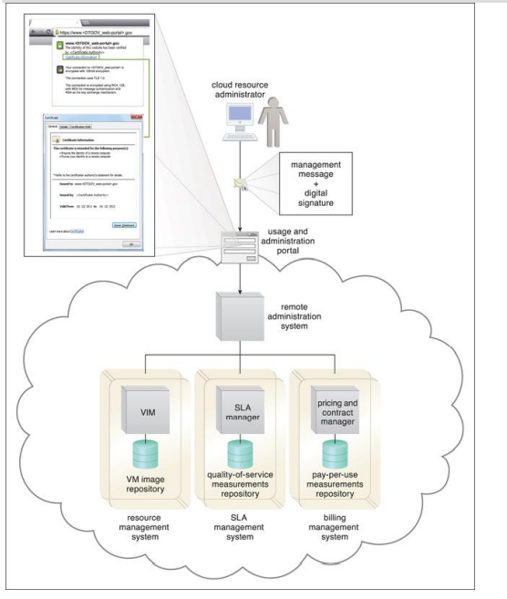
An external cloud resource administrator uses a digital certificate to access the Web based management environment. DTGOV’s digital certificate is used in the HTTPS connection and then signed by a trusted CA

Slide 50
Identity and Access Management (IAM)
The identity and access management (IAM) mechanism encompasses the components and policies necessary to control and track user identities and access privileges for IT resources, environments, and systems.
It consists of 4 components
1. Authentication.
2. Authorization.
3. User management.
4. Credential management.

Slide 51
Authentication: Username and password are the common form of authentication credentials managed by the IAM system, which can also supports digital signatures, digital certificates, biometric hardware(fingerprint), specialized software(voice analysis) and locking user accounts registered to IP or MAC addresses.
Authorization: It defines the access granularity control and oversees the relationship between user identities, access control rights and IT resources availability.
User Management: It is a program responsible for creating user identities, access groups, resetting passwords, defining password policies, and managing privileges.
Credential Management: It establishes identities and access control rules for defined user accounts which mitigates the threat of insufficient authorization.
The IAM mechanism is primarily used to counter the insufficient authorization, denial of service, and overlapping trust boundaries threats.

Slide 52
Case study Example
ATN’s legacy landscape has become complex and highly heterogeneous. Maintenance costs have increased due to redundant and similar applications and databases running concurrently. Legacy repositories of user credentials are just as assorted. Now that ATN has ported several applications to a PaaS environment, new identities are created and configured in order to grant users access.
The Cloud Enhance consultants suggest that ATN capitalize on this opportunity by starting a pilot IAM system initiative, especially since a new group of cloud-based identities is needed.
ATN agrees, and a specialized IAM system is designed specifically to regulate the security boundaries within their new PaaS environment. With this system, the identities assigned to cloud-based IT resources differ from corresponding on-premise identities, which were originally defined according to ATN’s internal security policies.

Slide 53
Single Sign-On (SSO)
Propagating the authentication and authorization information for a cloud service consumer across multiple cloud services can be a challenge.
The single sign on mechanism enables one cloud service consumer to be authenticated by security broker which establishes a security context that is persisted while the cloud service consumer access other cloud services or cloud based IT resources. Otherwise the consumer reauthenticate for each subsequent request.
The SSO mechanism essentially enables mutually independent cloud services and IT resources to generate and circulate runtime authentication and authorization credentials.
The credentials initially provided by the cloud service consumer remain valid for the duration of a session, while its security context information is shared.

Slide 54
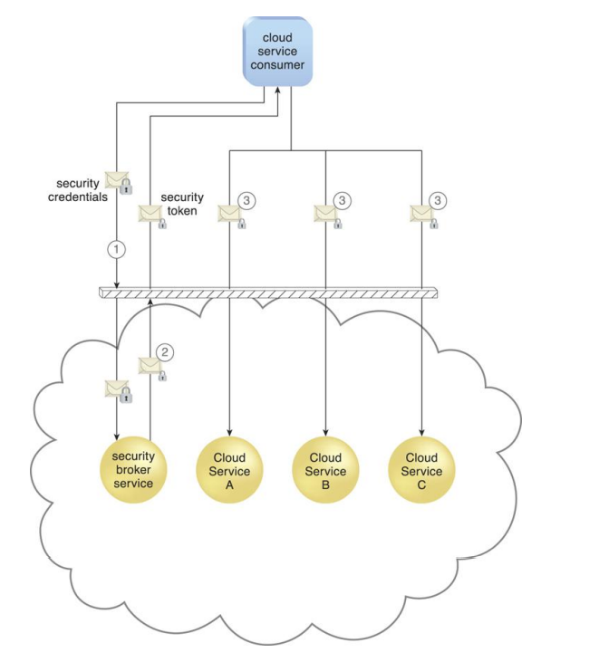
A cloud service consumer provides the security broker with login credentials (1). The security broker responds with an authentication token (message with small lock symbol) upon successful authentication, which contains cloud service consumer identity information (2) that is used to automatically authenticate the cloud service consumer across Cloud Services A, B, and C (3)

Slide 55
Case study Example
The migration of applications to ATN’s new PaaS platform was successful, but also raised a number of new concerns pertaining to the responsiveness and availability of PaaS-hosted IT resources. ATN intends to move more applications to a PaaS platform, but decides to do so by establishing a second PaaS environment with a different cloud provider. This will allow them to compare cloud providers during a three-month assessment period.
To accommodate this distributed cloud architecture, the SSO mechanism is used to establish a security broker capable of propagating login credentials across both clouds. This enables a single cloud resource administrator to access IT resources on both PaaS environments without having to log in separately to each one.

Slide 56
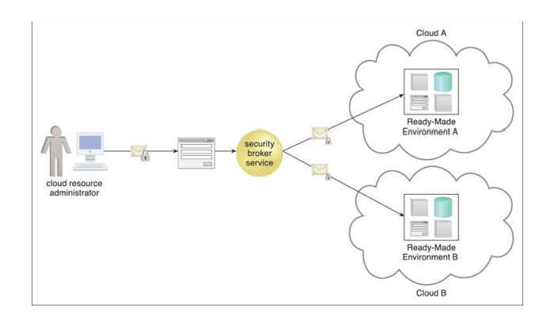
The credentials received by the security broker are propagated to readymade environments across two different clouds. The security broker is responsible for selecting the appropriate security procedure with which to contact each cloud.

Slide 57
Cloud-Based Security Groups
Cloud resource segmentation is a process by which separate physical and virtual IT environments are created for different users and groups.
For example, an organization’s WAN can be partitioned according to individual network security requirements. One network can be established with a resilient firewall for external Internet access, while a second is deployed without a firewall because its users are internal and unable to access the Internet.
Resource segmentation is used to enable virtualization by allocating a variety of physical IT resources to virtual machines. It needs to be optimized for public cloud environments, since organizational trust boundaries from different cloud consumers overlap when sharing the same underlying physical IT resources.

Slide 58
The cloud-based resource segmentation process creates cloud-based security group mechanisms that are determined through security policies.
Networks are segmented into logical cloud-based security groups that form logical network perimeters.
Each cloud-based IT resource is assigned to at least one logical cloud-based security group.
Each logical cloud-based security group is assigned specific rules that govern the communication between the security groups.
Multiple virtual servers running on the same physical server can become members of different logical cloud-based security groups shown in the following fig.

Slide 59
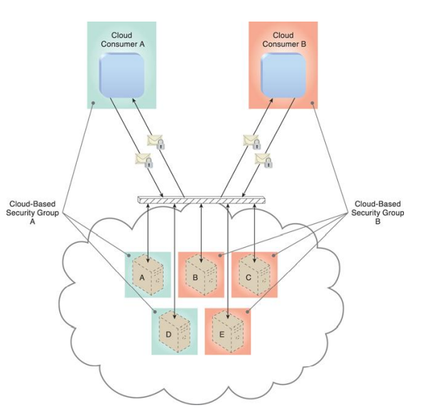
Cloud-Based Security Group A encompasses Virtual Servers A and D and is assigned to Cloud Consumer A. Cloud-Based Security Group B is comprised of Virtual Servers B, C, and E and is assigned to Cloud Consumer B. If Cloud Service Consumer A’s credentials are compromised, the attacker would only be able to access and damage the virtual servers in Cloud-Based Security Group A, thereby protecting Virtual Servers B, C, and E
This mechanism can be used to help counter the denial of service, insufficient authorization, and overlapping trust boundaries threats, and is closely related to the logical network perimeter mechanism.

Slide 60
Case Study Example
DTGOV has itself become a cloud provider, security concerns are raised pertaining to its hosting of public-sector client data. A team of cloud security specialists is brought in to define cloud-based security groups together with the digital signature and PKI mechanisms.
Security policies are classified into levels of resource segmentation before being integrated into DTGOV’s Web portal management environment. Consistent with the security requirements guaranteed by its SLAs, DTGOV maps IT resource allocation to the appropriate logical cloud-based security group (Figure), which has its own security policy that clearly stipulates its IT resource isolation and control levels.

Slide 61
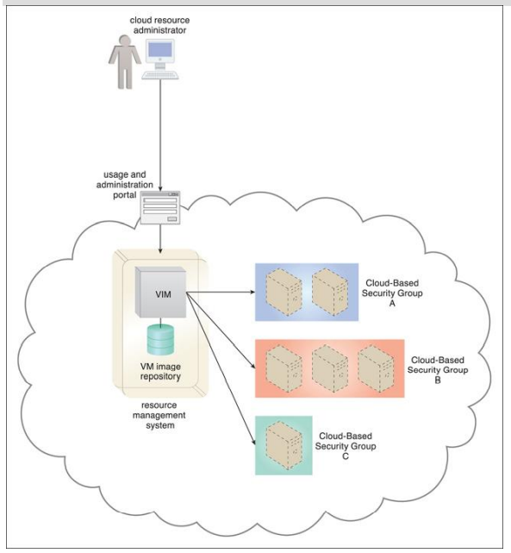
When an external cloud resource administrator accesses the Web portal to allocate a virtual server, the requested security credentials are assessed and mapped to an internal security policy that assigns a corresponding cloud-based security group to the new virtual server.

Slide 62
Hardened Virtual Server Images
A virtual server is created from a template configuration called a virtual server image (or virtual machine image).
Hardening is the process of stripping unnecessary software from a system to limit potential vulnerabilities that can be exploited by attackers. Removing redundant programs, closing unnecessary server ports, and disabling unused services, internal root accounts, and guest access are all examples of hardening.

Slide 63
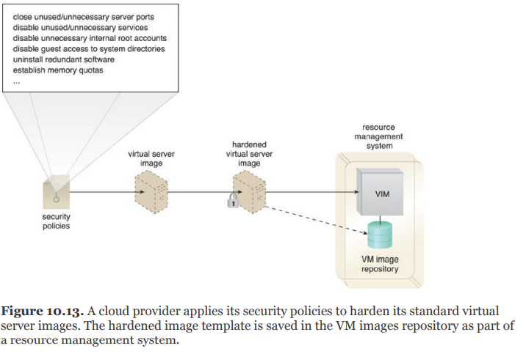
A hardened virtual server image is a template for virtual service instance creation that has been subjected to a hardening process. This generally results in a virtual server template that is significantly more secure than the original standard image.
Hardened virtual server images help counter the denial of service, insufficient authorization, and overlapping trust boundaries threats.

Slide 64
Case study Example
One of the security features made available to cloud consumers as part of DTGOV adoption of cloud-based security groups is an option to have some or all virtual servers within a given group hardened (Figure 10.14). Each hardened virtual server image results in an extra fee but spares cloud consumers from having to carry out the hardening process themselves.

Slide 65
